Slide 1
Reconfigurable Computing
History

Slide 2
1. Gerald Estrin Fix-Plus Machine
Vision of a restructurable computer system
“Pragmatic problem studies predicts gains in computation
speeds in a variety of computational tasks when executed
on appropriate problem-oriented configurations of the
variable structure computer.
The economic feasibility of the system is based on utilization of essentially the same hardware in a variety of special purpose structures. This capability is achieved by programmed or physical restructuring of a part of the hardware.”
G. Estrin, B. Bussel, R. Turn, J Bibb (UCLA 1963)
G. Estrin and R. Turn, “Automatic assignment of computations in a variable structure computer system,” IEEE Transactions on Electronic Computers, vol. 12, no. 5, pp. 755–773, 1963.

Slide 3
1. Gerald Estrin Fix-Plus Machine
Fixed plus Variable structure computer
Proposed by G. Estrin in 1959
Three parts:
A high-speed general purpose computer (fixed part F).
A variable part (V) consisting of various size high-speed digital substructures
is reorganized in a problem oriented special-purpose configurations
The supervisory control (SC) coordinates operations between the fix module and the variable module.
Speed gain over IBM7090 (2.5 to 1000)

Slide 4
Gerald Estrin Fix-Plus Machine
The Fixed Part (F)
Was initially an IBM 7090, but could be any general purpose computer
The Variable Part (V)
Made upon a set of problem-specific optimized functional units in the basic configuration (trigonometric functions, logarithm, exponentials, n-th power, roots, complex arithmetic, hyperbolic, matrix operation)

Slide 5
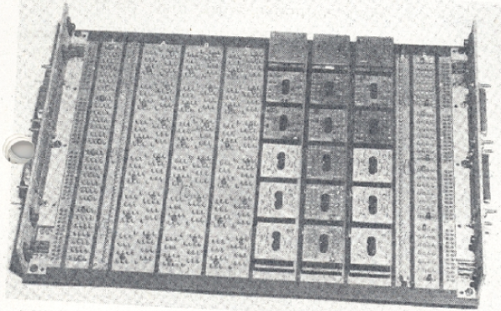
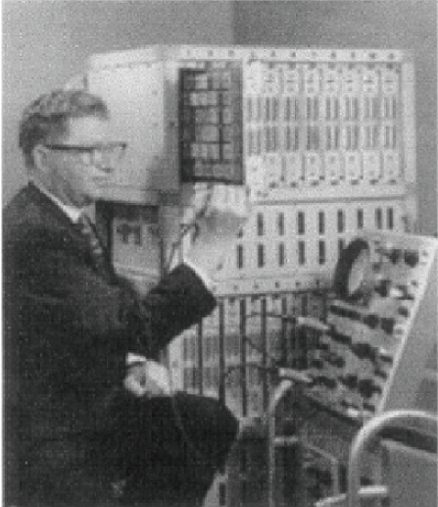
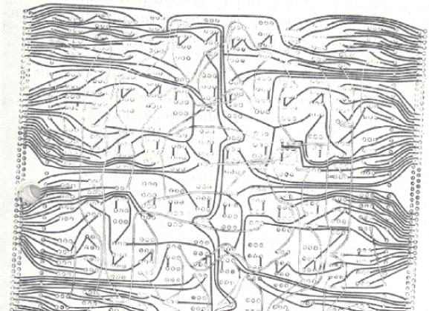
Gerald Estrin Fix-Plus Machine
Reconfiguration:
Manually by replacing some modules on the motherboard
or by changing a wiring harness for a new connection among the existing modules.

Slide 6
Rammig Machine
Goal:
“investigation of a system, which, with no manual or mechanical interference, permits the building, changing, processing and destruction of real (not simulated) digital hardware.”
F. J. Rammig, “A concept for the editing of hardware resulting in an automatic hardware-editor,” in Proceedings of 14th Design Automation Conference, New Orleans, 1977, pp. 187–193.

Slide 7
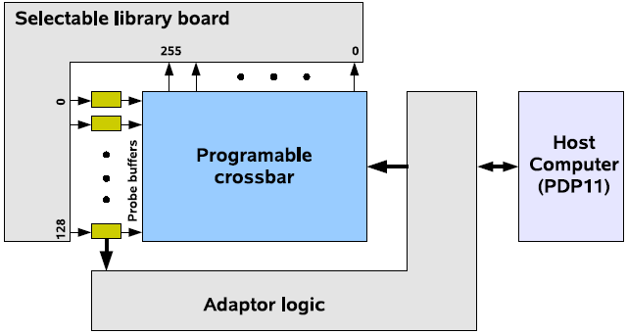
Rammig Machine
Hardware Editor:
Made upon a set of modules, a set of pins and a one-to-one mapping function on the set of pins.
The circuitry of a given function: defined as a “string” on an alphabet of two letters (w=“wired” and u = “unwired”).
Implemented by a programmable crossbar switch
Bitstream controlling crossbar switches: stored in registers (accessible by host)

Slide 8
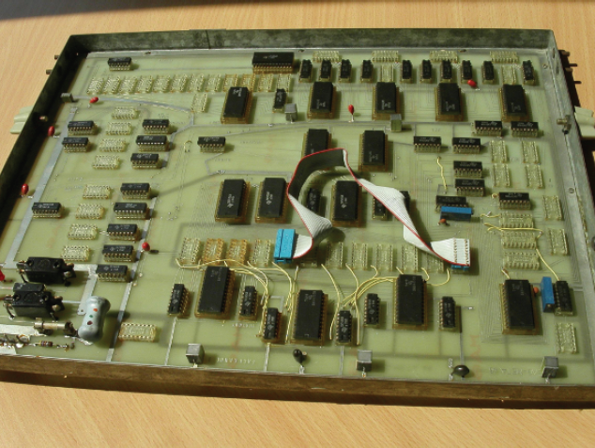
Ramming Machine
The modules
provided on a library board
similar to that of Estrin’s Fix-Plus.
Each board
selected under software control
Application:
heavily used as emulation platform.

Slide 9
تراشه ها ي منطقي برنامه پذ ير
بلوک‌های منطقی
Logic Blocks

Slide 10
Digital Devices

Slide 11
FPLD
Field-Programmable Logic Devices:
SPLD, CPLD, FPGA
FPGA is mostly used.

Slide 12
FPGA vs. ASIC
ASIC:
Months to fabricate
Cost: hundreds of thousands to millions of dollars to obtain the first device
FPGAs:
Configured in < 1 sec
Cost: a few dollars to a few thousand dollars
Versal ACAP: $12000
x20 to x35 area
x3 to x4 slower
x10 more dynamic power

Slide 13
Industry Main Players
Altera -> Intel -> Altera (Intel’s standalone company, March 2024)
Xilinx -> AMD (Feb. 2022)
Lattice
Actel → MicroSemi → Microchip (May 2018)
Cypress -> Infineon (April 2020)
Atmel → Microchip (Jan. 2016)

Slide 14
Industry Main Players
https://www.linkedin.com/pulse/top-10-fpga-manufacturers-world-ebics-fpga/

Slide 15
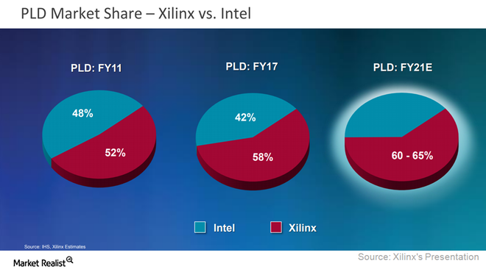
FPGA Market
https://www.fool.com/investing/2018/08/14/intel-is-gaining-against-its-biggest-rival-in-this.aspx

Slide 16
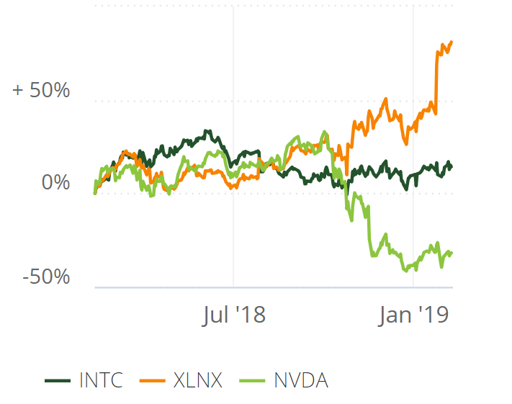
FPGA Market
Stock price: 2018-2019

Slide 17
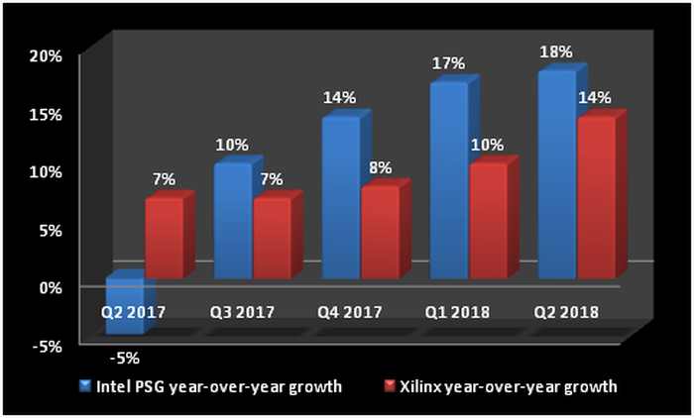
FPGA Market
https://www.fool.com/investing/2018/08/14/intel-is-gaining-against-its-biggest-rival-in-this.aspx
Notes:
PSG: programmable solutions group

Slide 18
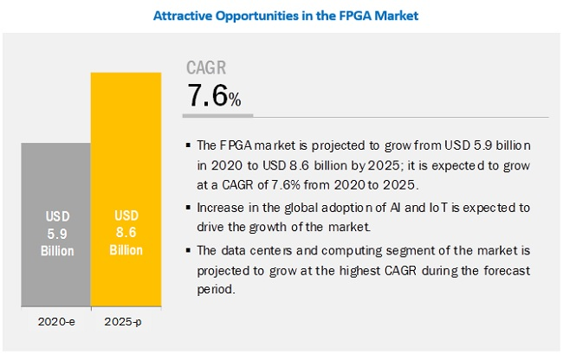
FPGA Market
FPGA market growth Forecast (2020-2025)
Growth rate: 7.6%
Driven by AI and IoT industry
https://www.marketsandmarkets.com/Market-Reports/fpga-market-194123367.html?gclid=CjwKCAiAm-2BBhANEiwAe7eyFCwYl3i9aw8zLqdOxmKr0ugfup7BiLKqBlWJzldY5ILN8Z6_PE0yFhoCxUQQAvD_BwE

Slide 19
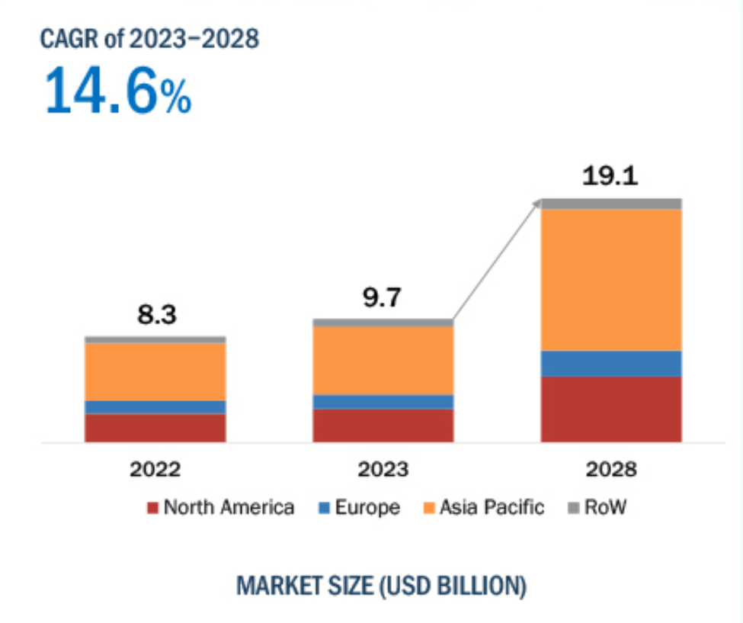
FPGA Market
FPGA market growth Forecast (2023-2028)
Growth rate: 14.6%
Driven by AI and IoT industry
Last News (2024):
Market Size:
12.1 B
Forecast (2029):
25.8 B
CAGR:
16.4
https://www.marketsandmarkets.com/Market-Reports/fpga-market-194123367.html#:~:text=FPGA%20Market%20Size

